Slide 1
Networks 2: Classical ideas and more technical measures
3/16/2022
Xuewen Yan

Slide 2
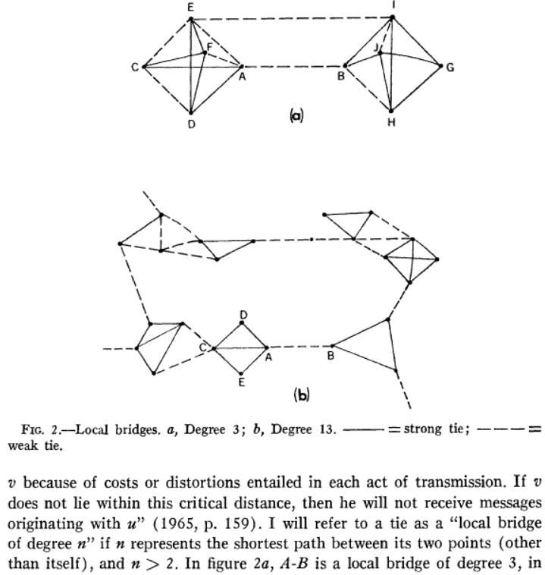
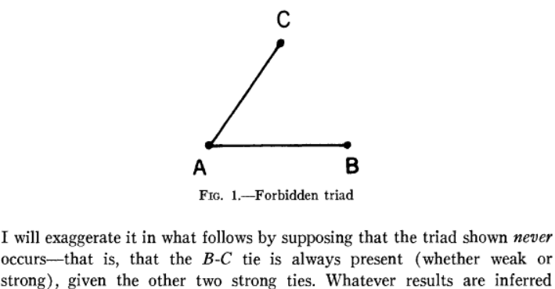
Granovetter, Mark. 1973. “The Strength of Weak Ties.” The American Journal of Sociology 78 (6): 1360–80.

Slide 3
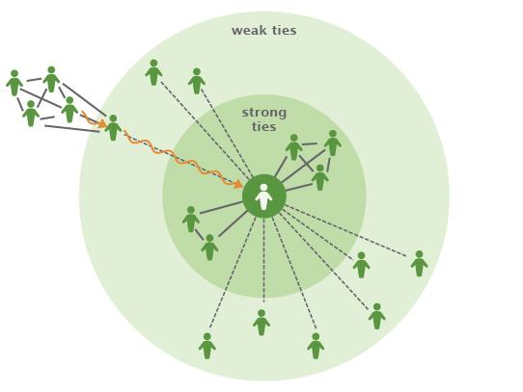
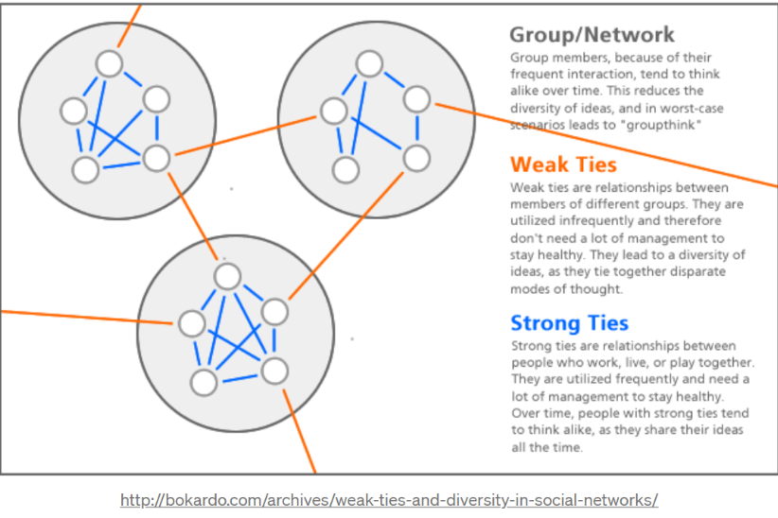
Weak ties and job search
Weak ties and community organization

Slide 4
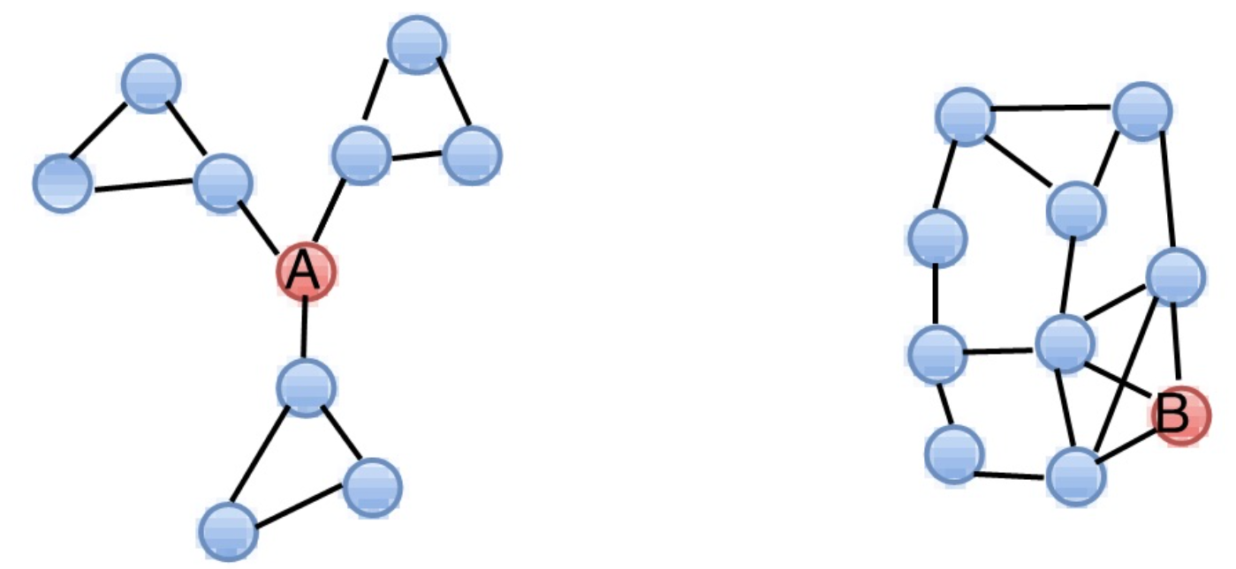
Structural holes and brokerage
Burt, Ronald S. (2010). Neighbor Networks: Competitive Advantages Local and Personal. Oxford University Press.
Burt, Ronald S. (1982). Toward a Structural Theory of Action: Network Models of Social Structure, Perception, and Action. Academic Press.
Burt, Ronald S. (2004). "Structural Holes and Good Ideas". American Journal of Sociology. 110 (2): 349–399.

Slide 5
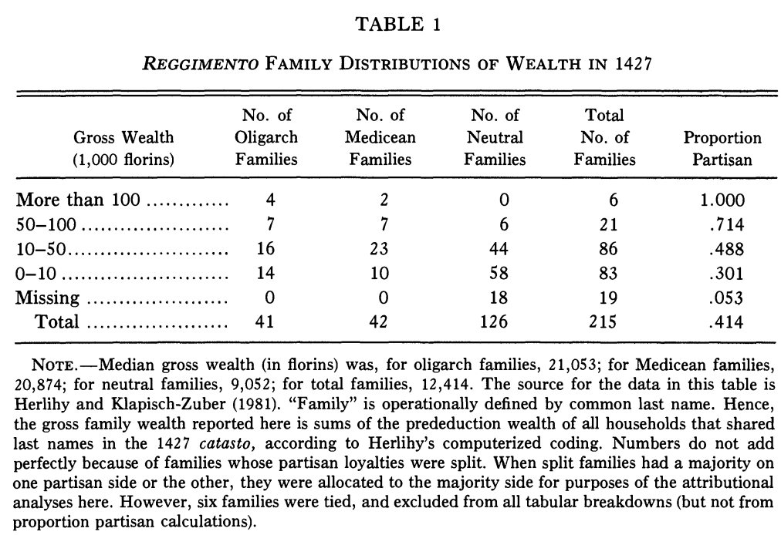
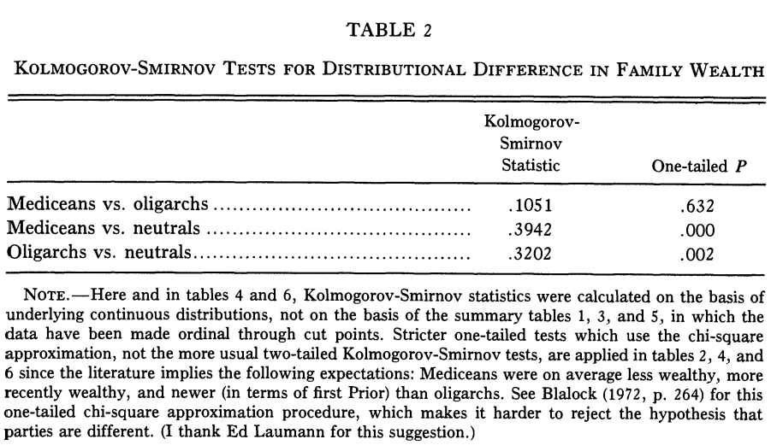
Padgett, John F., and Christopher K. Ansell. 1993. “Robust Action and the Rise of the Medici, 1400-1434.” The American Journal of Sociology 98 (6): 1259–1319

Slide 6
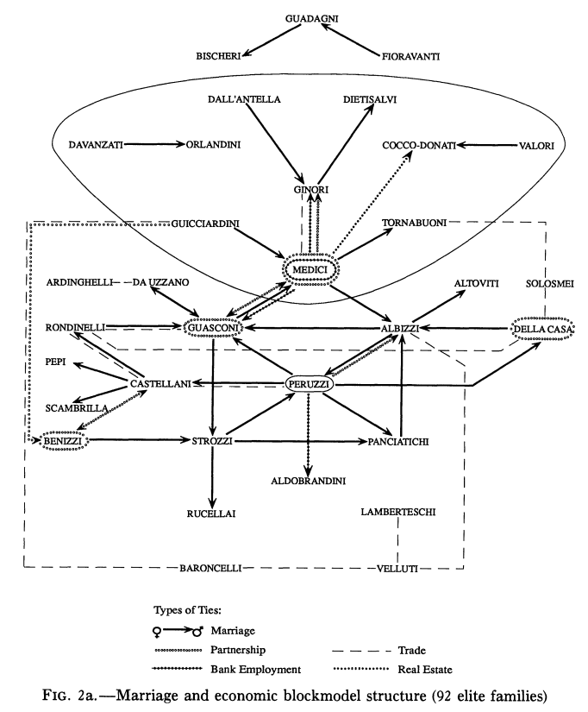
The Medici party was an extraordinarily centralized "star" or "spoke" network system, with few intra-elite network ties.
Conversely, the oligarch side was densely interconnected, especially through marriage.
Control and collective action?

Slide 7
Degree centrality
Number of adjacent ties
Out-degree: embeddedness; involvement
In-degree: ‘prestige’, ‘popularity’

Slide 8
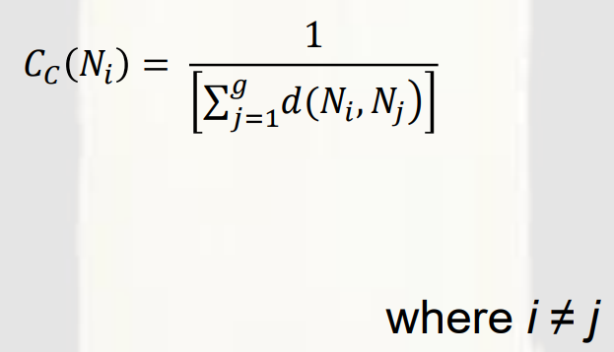
Closeness centrality
A node is reachable from another node is there exists a path between them.
A path is a sequence of nodes and edges in a graph such that each node and edge of the path is contained in the graph
（Geodesic) distance: Shortest path between two nodes.
Question: What about unreachable nodes in the network?
Reciprocal（倒数） of the sum of the geodesic distance between a given node and each other node in the network

Slide 9
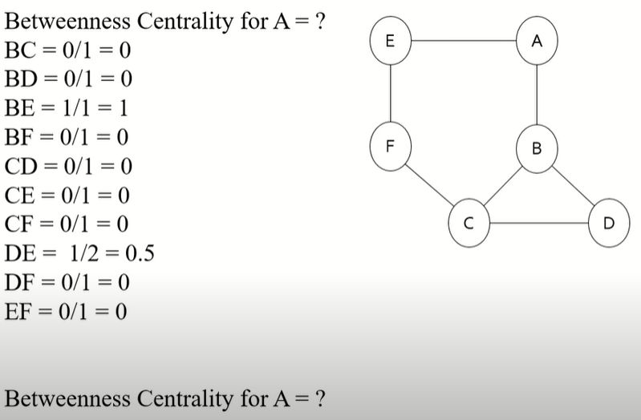
Betweenness centrality
Betweenness centrality: For every pair of the network (excluding node A), how many times the shortest paths (geodesic distance) between this pair of nodes must pass node A?
To what extent does the travel between nodes rely on a given actor/node?

Slide 10
Exercise
Suppose a network refers to friendship network. Each node represents a person, and each edge represents friendship between the persons at ends. If you are interested in finding the most poplar person in the network, which centrality measure is the most appropriate?
Suppose a network refers to information flow network of an organization. Each node represents a section in the organization, and each edge represents a possible information exchange between the sections at ends.
If you are interested in finding the section that can most frequently control information flow in the network, which centrality measure is the most appropriate? Give the answer with reasons why it is the most appropriate.
If you are interested in finding the section that can most efficiently obtain information from every other section, which centrality measure is the most appropriate?

Slide 11
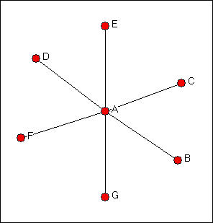

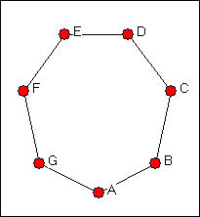
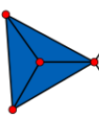
Star, line, ring, clique

Slide 12
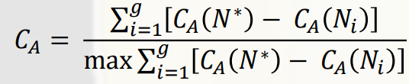
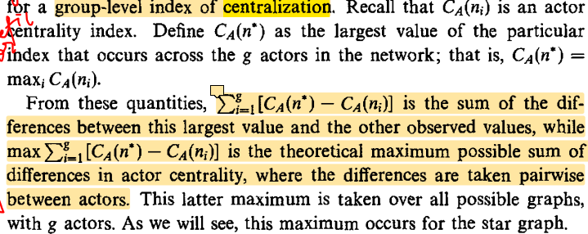
Group centralization
Wasserman, Stanley, and Katherine Faust. 1994. Social Network Analysis: Methods and Applications (Structural Analysis in the Social Sciences Book 8). Cambridge University Press

Slide 14
Glossary & homework

